Slide 1


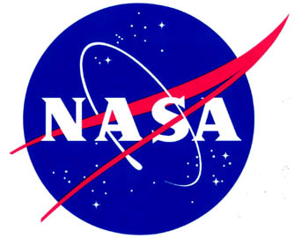

The Importance of Science Writing
Tim Johnson
Northern Arizona University
Mentor: Chris Etling of the Arizona Daily Sun

Slide 2
The Purpose of Science Writing
Translate scientific jargon into everyday language
Original: “Powered external orthotics reduce metabolic function during ambulatory exercise despite hetereogeneity.”
Translated: “Exoskeletons make it easier to walk.”
Publicize important developments
Show that science grows everywhere

Slide 3
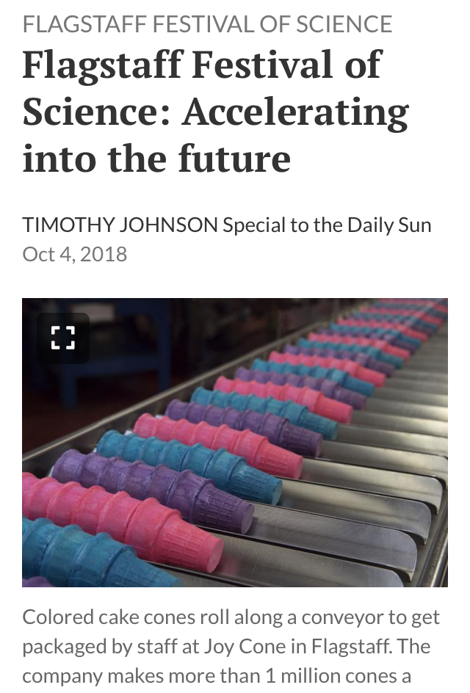
Science Is Relevant to Everyone
Self-driving cars by Raj Rajkumar
Joycone
Local factory creates 1 million cones per day
Automation is here

Slide 4
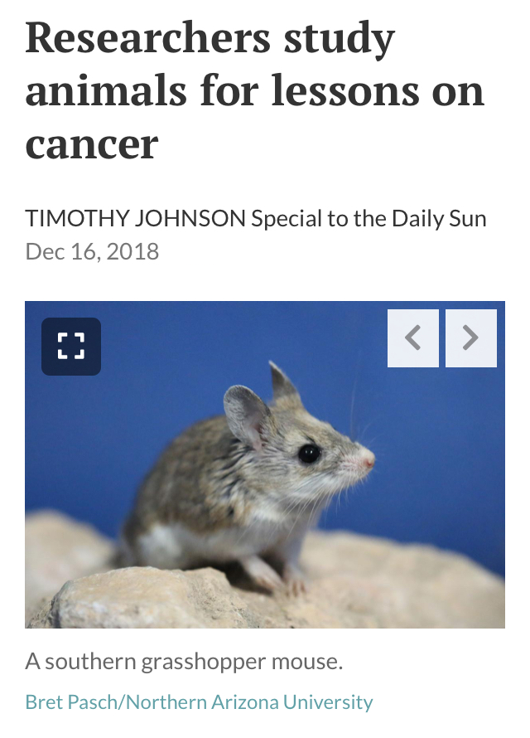
Science Affects Your Health
Cancer research at NAU
Study of how other species fight cancer
Everyone has a personal connection
with cancer
Rehabilitation robotics and cerebral palsy

Slide 5
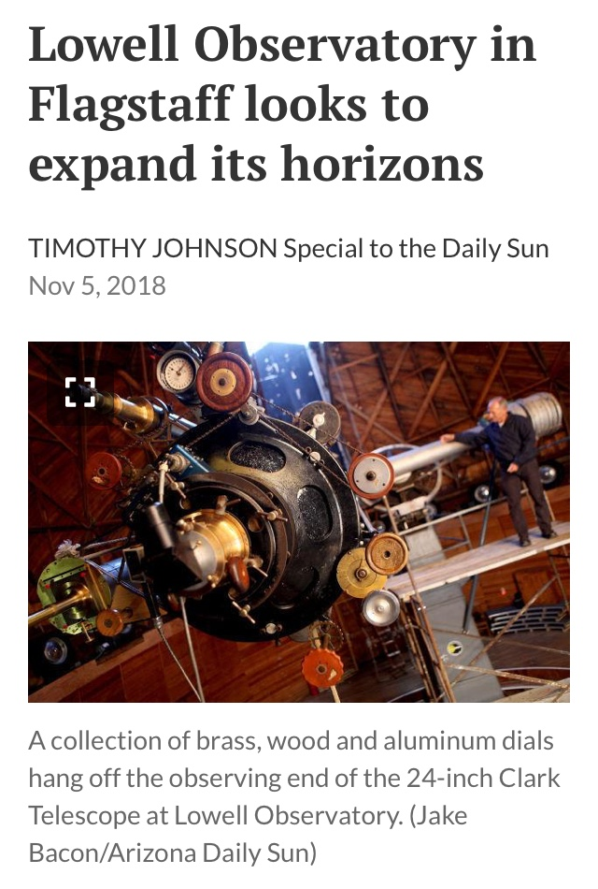
Science Should Be Accessible
Flagstaff loves Lowell Observatory
Interview with Kevin Schindler
Original purpose was to make science
accessible to public

Slide 6
Talking to Reporters
Know your topic
Definitions, background, stats
Favorite aspects? Challenges?
What’s next?
Be friendly!

Slide 7
Acknowledgements
AZ Daily Sun
Chris Etling and Nancy Wiechec
NAU NASA Space Grant
Nadine Barlow and Kathleen Stigmon
Any Questions?

